Slide 1
AirDat32A.exe
(US Standard Day Atmosphere)
Utility by
Kelan Sisk

Slide 2
Disclaimer
Redistribution and use of the AirDat32A executable is permitted provided that the following condition is met:
Redistributions must reproduce this condition and the following disclaimer in the documentation and/or other materials provided with the distribution.
THIS SOFTWARE IS PROVIDED “AS IS” AND ANY EXPRESS OR IMPLIED WARRANTIES, INCLUDING BUT NOT LIMITED TO, THE IMPLIED WARRANTIES OF MERCHANTABILITY AND FITNESS FOR A PARTICULAR PURPOSE ARE DISCLAIMED. IN NO EVENT SHALL THE AUTHOR BE LIABLE FOR ANY DIRECT, INDIRECT, INCIDENTAL, SPECIAL, EXEMPLARY, OR CONSEQUENTIAL DAMAGES (INCLUDING BUT NOT LIMITED TO, PROCUREMENT OF SUBSTITUE GOODS OR SERVICES, LOSS OF USE, DATA, OR PROFITS, OR BUISINESS INTERRUPTION) HOWEVER CAUSED AND ON ANY THEORY OF LIABILITY, WHETHER IN CONTRACT, STRICT LIABILITY, OR TORT (INCLUDING NEGLIGENCE OR OTHERWISE) ARISING IN ANY WAY OUT OF THE USE OF THIS SOFTWARE, EVEN IF ADVISED OF THE POSSIBILITY OF SUCH DAMAGE.

Slide 3
AirDat32A.exe
Compiled using Microsoft Visual Basic 6.0
Past versions include
  AirData, AirDataF, AirData5, and AirDat32
Requires a dynamic link library (DLL)
  MSVBVM60.DLL
  Past versions require other DLL files

Slide 4

AirDat32A - Installation Notes
Due to email firewall’s the code is sometimes distributed after being renamed as a text file
Copy the file to a directory of your choice
Rename the file extension if necessary (to “.exe”)
Make a shortcut (i.e., on the desktop) as you desire
Execute the code by double clicking on either the executable or the shortcut

Slide 5
AirDat32A - What does it do?
Given - two valid inputs
Solves for:
  Pressure Altitude
  Air Speed (True, Equivalent, and Calibrated)
  Mach
  Dynamic and Impact Pressure
  Static Pressure and Density (output only)
    also Pressure and Density ratios (output only)

Slide 6
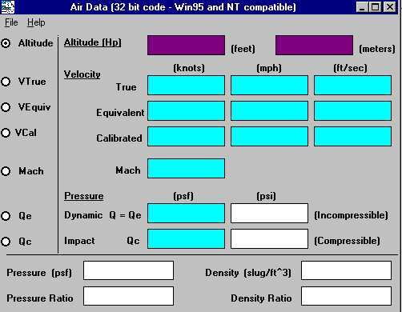
AirDat32A -
What are Valid Input Pairs?
Use the Radio Buttons to
select the PRIMARY input variable.
Primary input fields will be colored Purple.
Valid SECONDARY input fields will be colored Cyan.
Data entry into one Primary (purple) and one Secondary (cyan) field defines a valid input pair.

Slide 7
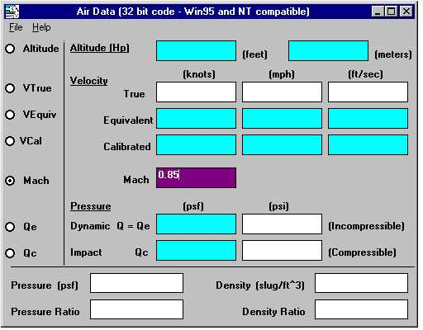
AirDat32A - Input Example
Step 1:
Select Mach as the PRIMARY input variable.
The Mach input field is automatically colored Purple and the cursor placed inside the field.
Step 2:
Enter a Mach: 0.85
All valid SECONDARY fields are now colored Cyan. Output only fields are colored White.

Slide 8
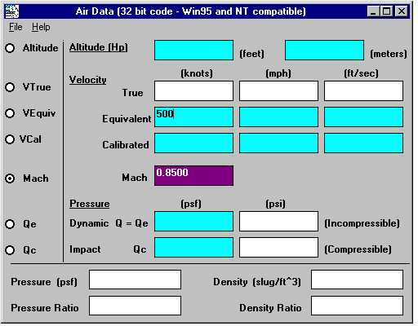
AirDat32A - Input Example
Step 3:
Click (or use the arrow keys) to select the desired Secondary entry field (Cyan).
Example: KEAS
(knots equivalent air speed)
Step 4:
Enter a value for KEAS: 500
Step 5:
Pressing the Enter key will initiate a solution attempt.

Slide 9
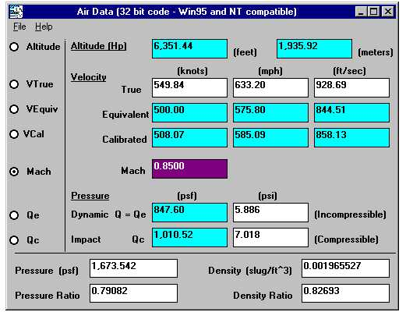
AirDat32A - Input Example
Note: Each field has a fixed format which is not intended to represent the true significant digits of the solution.
Whenever a field loses focus or a computational output is placed into a field, the fixed format is applied.
This is bad coding on my part but is not easily corrected short of a major rewrite.
Maybe if I was funded to give it a complete rewrite ...

